Slide 1
CENG-232 Logic Design
Lecture 2
Boolean Algebra & Logic Gates

Slide 2
Overview
Boolean Algebra
Switching Algebra
Algebraic Minimization
Standard forms
Karnaugh Map Minimization
Other logic operators
IC families and characteristics
Read Chapters 1 & 2
Optional: Read Appendix A of the book

Slide 3
Boolean Algebra
The principles of logical thinking have been understood since the Hellenic era (c. 500- 300 BC)
George Boole in 1854 showed how to systemize these principles and express them in equations
Boolean logic or Boolean algebra
A deductive mathematical system
A set of elements
A set of operators
A number of unproved axioms or postulates
Postulates
Form the basic assumptions from which it is possible to deduce the rules, theorems and properties of the system
Notes:
Algebra: the reunion of broken parts
George Boole (1815-1864) developed Boolean logic
The principles of logical thinking have been understood (and occasionally used) since the Hellenic era.
Boole’s contribution was to show how to systemize these principles and express them in equations (called Boolean logic or Boolean algebra).

Slide 4
Switching Algebra
Based on Boolean Algebra
Developed by Claude Shannon in 1938 to represent the properties of bistable electrical switching circuits
showed how to use Boolean algebra as the basis for switching technology
systemized logical thinking for computer and communication systems, both for the design and programming of the systems and their applications.
Formal way to describe logic statements and determine truth of statements
Only has two-values domain (0 and 1)
Huntington’s Postulates (1904) define underlying assumptions
Notes:
Claude Shannon (1916-2001) showed how to use Boolean algebra as the basis for switching technology.
This contribution systemized logical thinking for computer and communication systems, both for the design and programming of the systems and their applications.

Slide 5
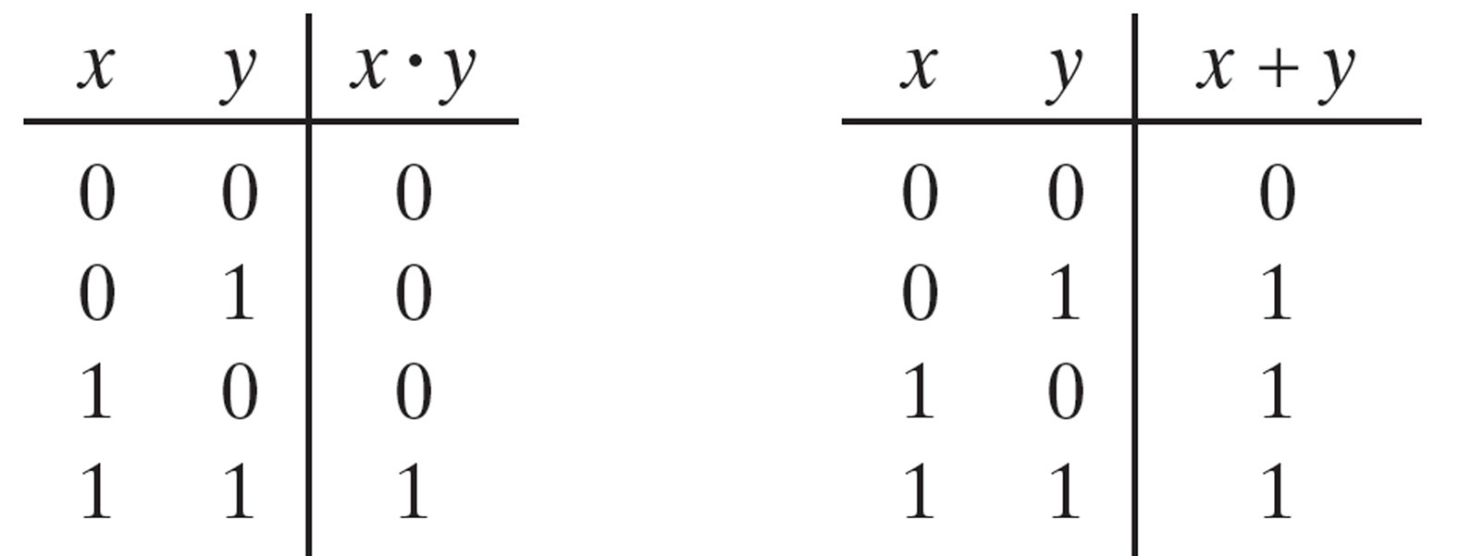
Switching Algebra
Switching Or Boolean Algebra
Defined by
A set of elements B = [0,1]
Two binary operators + and .
the rules of these operations
Huntington Postulates
Two-valued Boolean Algebra
With only two elements
Notes:
Claude Shannon (1916-2001) showed how to use Boolean algebra as the basis for switching technology.
This contribution systemized logical thinking for computer and communication systems, both for the design and programming of the systems and their applications.

Slide 6
Huntington’s Postulates
1. Closure
If X and Y are in set (0,1) then operations X+Y and X· Y are also in set (0,1)
2. Identity Element
X + 0 = X X · 1 = X
3. Commutativity
X + Y = Y + X X· Y = Y· X

Slide 7
Huntington’s Postulates (cont.)
4. Distributive
X · (Y + Z) = (X · Y) + (X · Z)
X + (Y · Z) = (X + Y) · (X + Z)
5. Complement
For every element X, there exists an element X’ such that
X + X’ = 1
X · X’ = 0
6. There exists at least two elements x, y such that x ≠ y

Slide 8
Huntington’s Postulates (cont.)
Duality Principle:
X + 0 = X X · 1 = X
X + Y = Y + X X· Y = Y· X
X · (Y + Z) = (X · Y) + (X · Z) X + (Y · Z) = (X + Y) · (X + Z)
X + X’ = 1 X · X’ = 0
Note that for each property, one form is the dual of the other;
(0’s to 1’s, 1’s to 0’s, ·’s to +’s, +’s to ·’s)

Slide 9
Switching Algebra Operations - NOT
Result of postulate 5
Unary complement or inversion operation
Usually shown as overbar (X), other forms are ~X, X’
X
0
1
X
1
0
~
X
X
X
X

Slide 10
Switching Algebra Operations - AND
Also known as the conjunction operation;
output is true (1) only if all inputs are true
Algebraic operators are “·”, “&”, “∧”
X
0
0
1
1
Y
0
1
0
1
X·Y
0
0
0
1
&

Slide 11
Switching Algebra Operations - OR
Also known as the disjunction operation;
output is true (1) if any input is true
Algebraic operators are “+”, “|”, “∨”
X
0
0
1
1
Y
0
1
0
1
X+Y
0
1
1
1
≥1

Slide 12
Logic Expressions
Z = X.Y + X.W operators
X, Y, W, Z logic literals
+, . logic variables
0, 1 logic expression

Slide 13
Logic Expressions
Terms and Definitions
Logic Expression - a mathematical formula consisting of logical operators and variables
Logic Operator - a function that gives a well defined output according to switching algebra
Logic Variable - a symbol representing the two possible switching algebra values of 0 and 1
Logic Literal - the values 0 and 1 or a logic variable or it’s complement
Z = X.Y + X.W logic expression
X, Y, W, Z logic variables
+, . operators

Slide 14
Logic Expressions - Precedence
Like standard algebra, switching algebra operators have a precedence of evaluation
NOT operations have the highest precedence
AND operations are next
OR operations are lowest
Parentheses explicitly define the order of operator evaluation
If in doubt, use PARENTHESES!

Slide 15
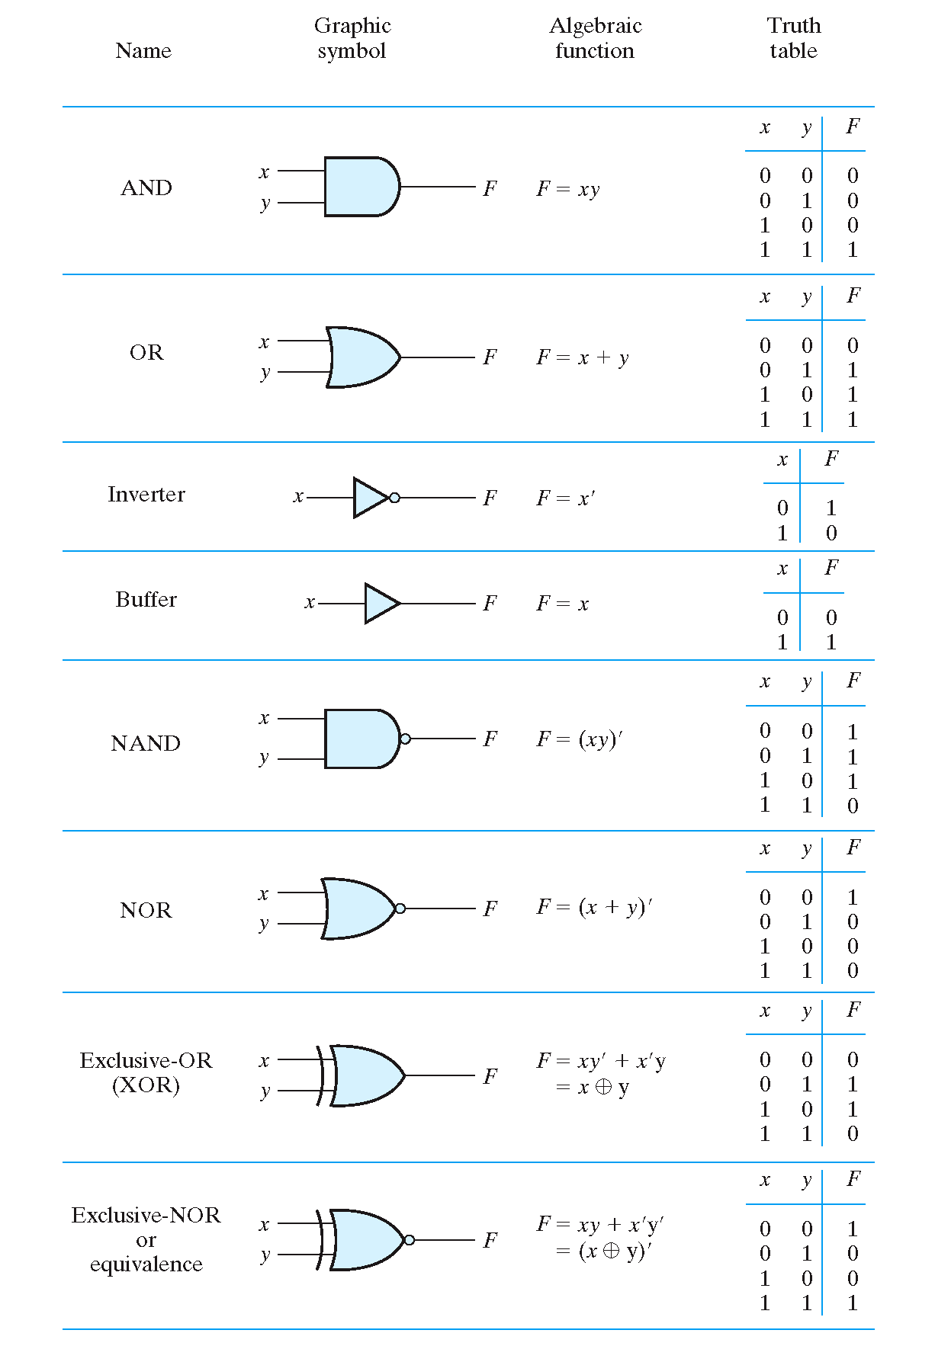

Slide 16
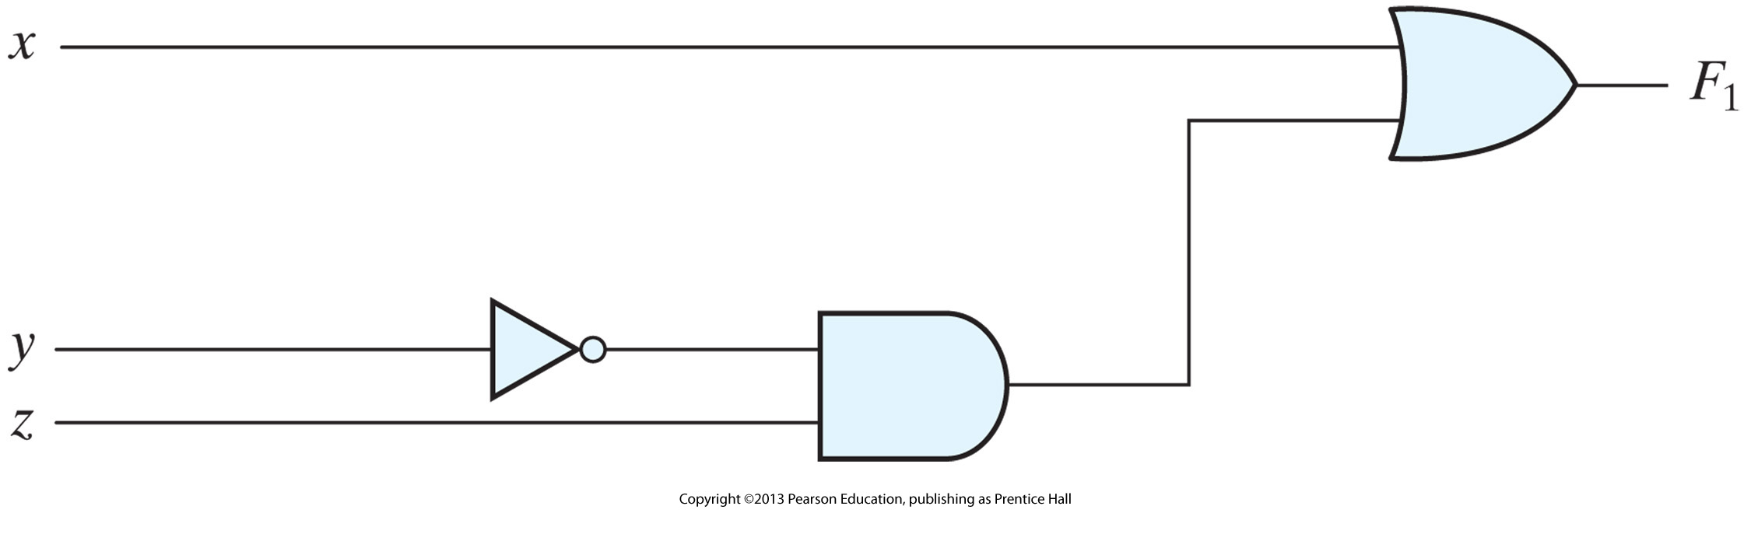
Logic Expressions vs. Logic Circuits
Each expression can be realized by a logic circuit
F₁ = x+y’z

Slide 17
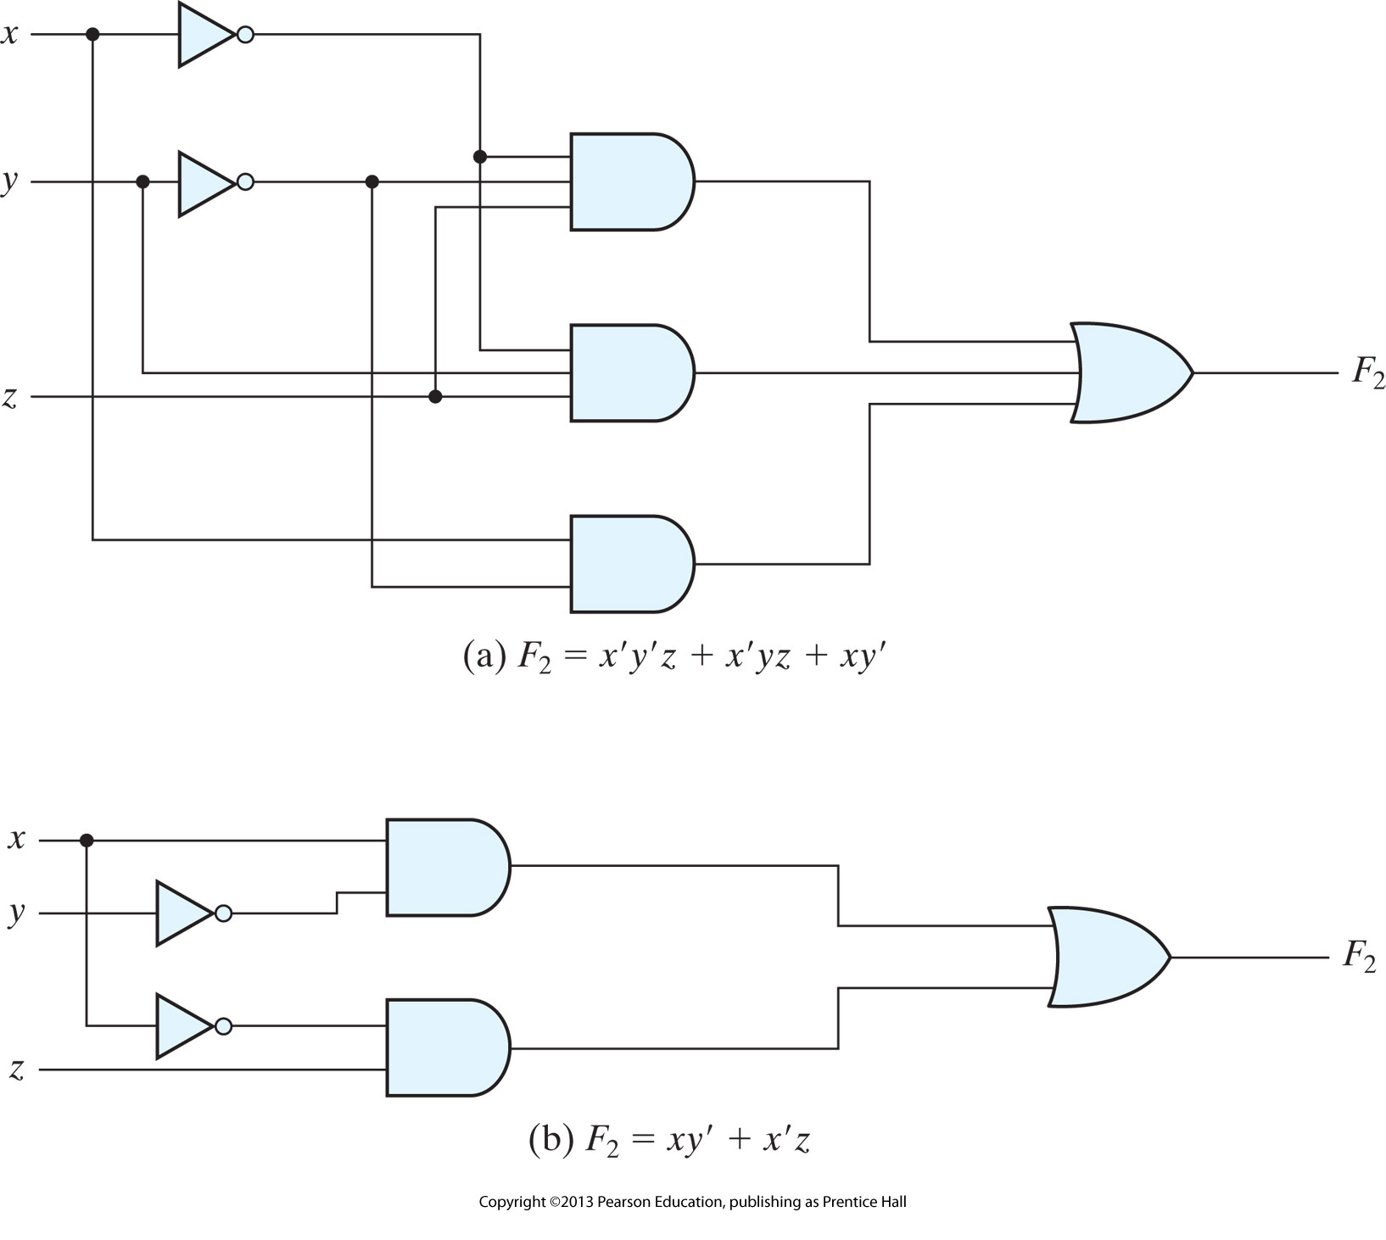
Logic Expressions vs. Logic Circuits

Slide 18
Logic Expressions vs. Logic Circuits
Each expression can be realized by a logic circuit
Multiple expressions for a single function
The simpler an expression is, the faster and cheaper its corresponding circuit is
So we try to simplify logic expressions if possible
We call it ‘minimization’

Slide 19
Logic Expression Minimization
Given a logic expression, the goal is to find another expression that:
a) has the same truth-table
b) has fewer variables per term
c) has fewer terms
d) needs less logic to implement
Example: E = A.B.C.D + A.B.C.D’ = A.B.C
There are three main manual methods
Algebraic minimization
Karnaugh Map minimization
Quine-McCluskey (tabular) minimization
[Assignment: Read this from the web]

Slide 20
Algebraic Minimization
Process is to apply the switching algebra postulates, laws, and theorems (that will follow) to transform the original expression
Hard to recognize when a particular law can be applied
Difficult to know if resulting expression is truly minimal
Very easy to make a mistake
Incorrect complementation
Dropped variables

Slide 21
Switching Algebra - Laws and Theorems
Involution:

Slide 22
Switching Algebra - Laws and Theorems
Identity:

Slide 23
Switching Algebra - Laws and Theorems
Idempotence:

Slide 24
Switching Algebra - Laws and Theorems
Associativity:

Slide 25
Switching Algebra - Laws and Theorems
Adjacency:

Slide 26
Switching Algebra - Laws and Theorems
Absorption:

Slide 27
Switching Algebra - Laws and Theorems
Simplification:

Slide 28
How to Prove?
Either use the postulates and simplify
X+(X’.Y) = X+Y (1)
or use distributive postulate
X+YZ = (X+Y).(X+Z)
So (1) can be simplified as:
(X+X’).(X+Y) = 1.(X+Y) = X+Y

Slide 29
How to Prove?
Truth Table Approach (for verification)
X Y X+(X’.Y) X+Y
0 0 0 0
0 1 1 1
1 0 1 1
1 1 1 1
Two output columns are the same!

Slide 30
Switching Algebra - Laws and Theorems
Consensus:

Slide 31
Switching Algebra - Laws and Theorems
DeMorgan’s Theorem:
General form:

Slide 32
DeMorgan's Theorem
Very useful for complementing function expressions:

Slide 33
Minimization via Adjacency
Adjacency is easy to use and very powerful
Look for two terms that are identical except for one variable
Application removes one term and one variable from the remaining term

Slide 34
Example of Adjacency Minimization
Adjacencies
Duplicate 3rd. term and rearrange (X+X=X)
Apply adjacency on “term pairs”

Slide 35
Another Algebraic Simplification Example
W = X’Y’Z+X’Y’Z’+XYZ+X’YZ+X’YZ’
= X’Y’+YZ +X’Z’
There are other solutions, too!

